Slide 1
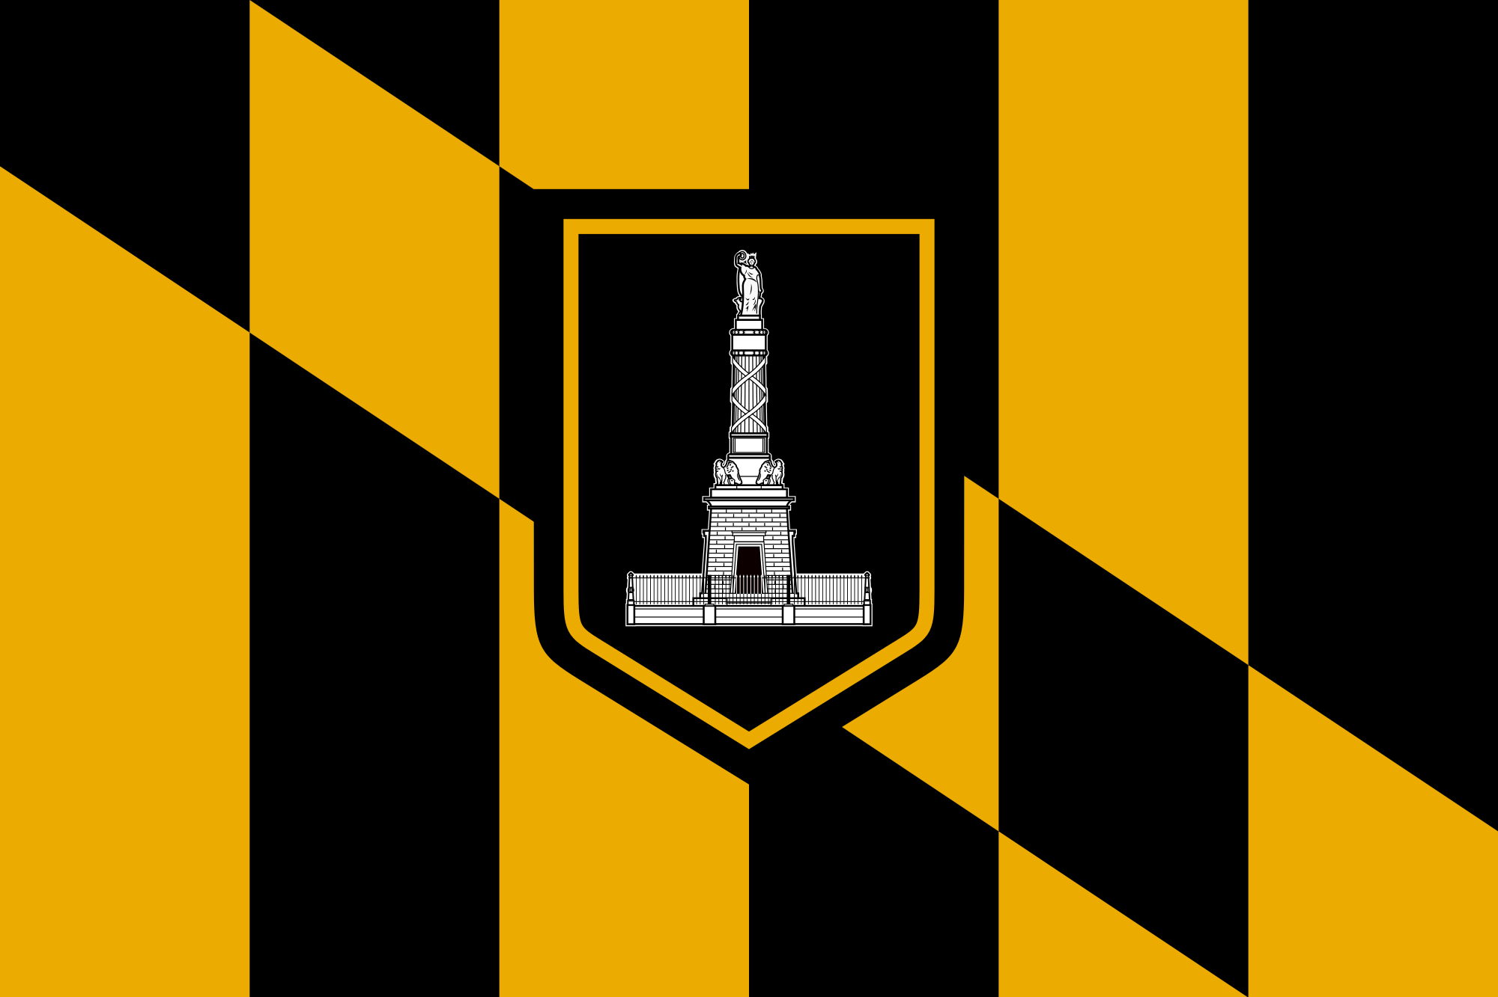
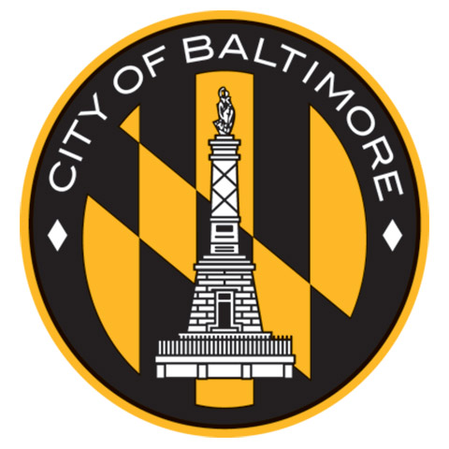
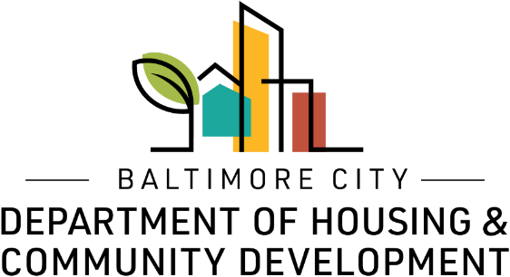
2019
capital Awards
Community Catalyst Grants

Slide 2
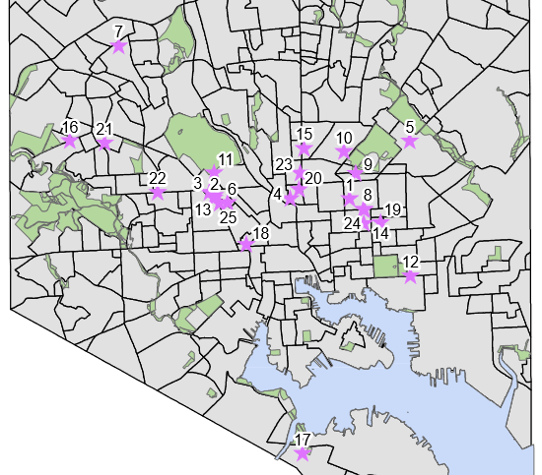
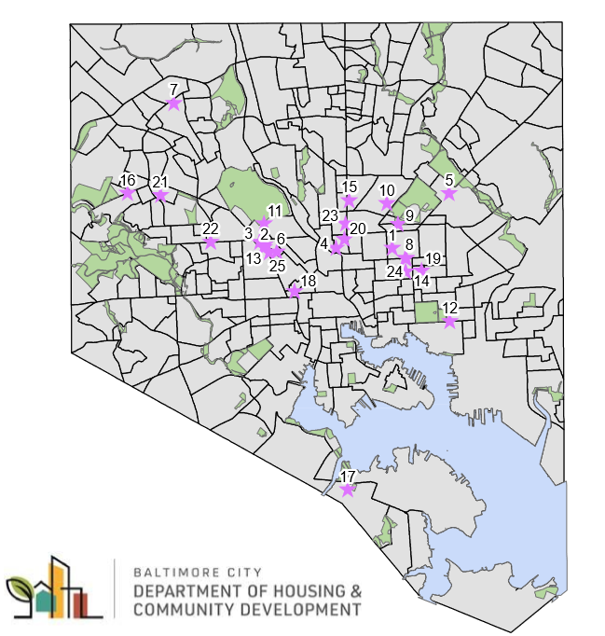

Slide 3
2019
capital Awards
Community Catalyst Grants

Slide 4
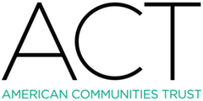
$87,000
Rehabilitation and construction of six vacant and derelict properties located on
Llewelyn Avenue and Oliver Street.

Slide 5

$180,120
Upgrade of the Club's electrical system, current museum and other planned rehabilitation of the building.

Slide 6
Arch Social Community Network
$100,000
Revitalization of 17 abandoned properties to build a new youth, cultural and economic facility.

Slide 7

$47,100
Renovation of vacant portion of the historic North Avenue Market into a performing arts venue and nonprofit headquarters.

Slide 8
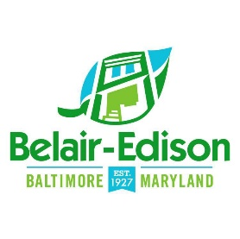
$76,448
Assist with targeting commercial rehabilitation efforts along the 3400 block of Belair Road.

Slide 9

$204,750
Reduce blight and train black women to rehabilitate five houses and sell them at affordable rates.

Slide 10
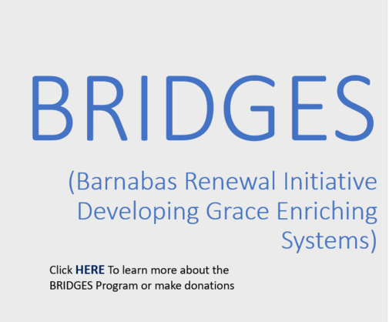
$300,000
Support executing a mixed income housing project offering families affording rental housing and townhomes for homeownership.

Slide 11
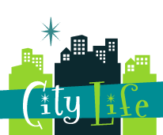
$125,000
Tenant improvements for new space in the
Hoen Lithograph Complex.

Slide 12
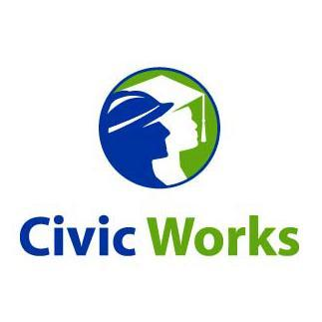
$225,000
Support the HUBS initiative, providing low-income older adult homeowners in Baltimore City with extreme emergency home repairs.

Slide 13
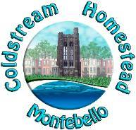
$125,000
Complete scattered site rehabilitation of 12 homes in partnership with
The Children’s Guild and Civic Works.

Slide 14
Countered
$90,000
Build a healthy corner store in the Madison Ave/ Penn- North neighborhood.

Slide 15
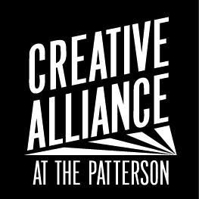
$125,000
Support redevelopment of a vacant commercial building in East Baltimore into a multicultural education center.

Slide 16
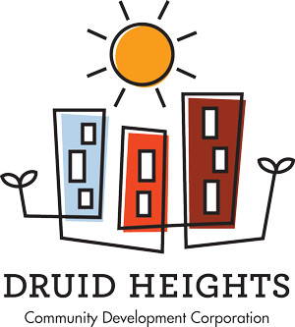
$125,000
Funding support for the Bakers View
Phase II project.

Slide 17

$125,000
Help support construction of a permanent home in three rowhomes on the campus of the
Henderson‐Hopkins school.

Slide 18
Forest Park Alliance /WBC CDC
$125,000
Assists with the acquisition, development, construction and renovation of vacant properties in each community.

Slide 19
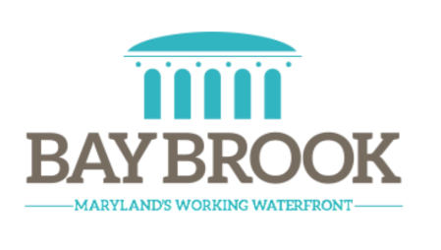
$125,000
Establish a program to provide subsidies to private investors to rehabilitate vacant or distressed commercial properties to get them move-in ready for new businesses.

Slide 20
Harwood Community
Association
$125,000
Improve the facades of 10 or more houses in the East Harwood Section of the Harwood Neighborhood.

Slide 21
Heritage Crossing Resident Association
$40,000
Redesign of deteriorated sign at
MLK Boulevard and Franklin Street entrance to community.

Slide 22

$65,000
Repair/renovation of exterior homes in the
Madison East End Development Project.

Slide 23
KMW/ Threshold, Inc.
$125,000
Support predevelopment and development activities associated with the new construction of 8‐10 residential town homes located in Baltimore’s Greenmount West Community.

Slide 24
Monarch Butterfly
& WBC
$158,000
Funding will support restoration of vacant properties in the Forest Park area.

Slide 25

$125,000
Tenant build out for the creation of a food hall with up to nine vendors at Walbrook Mill located on W. North Avenue.

Slide 26
People’s Homesteading
Group
$200,000
Help rehabilitate nine deteriorated, vacant houses and prepare for future homeowners, including low-to-moderate income.

Slide 27
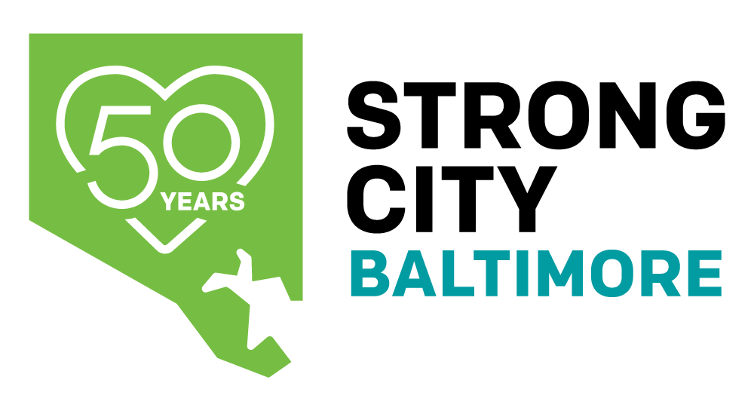
$250,000
Assists Strong City’s move to and expansion of programmatic operations at the
Hoen Lithograph Building.

Slide 28
$50,000
Support site development and construction of five store fronts and eight apartments along the Pennsylvania Avenue Corridor.

Slide 29
Congratulations
and
Thank you!

